Slide 1







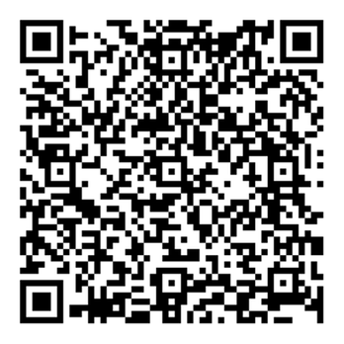


2025 SCOTTISH ACTUARIAL INNOVATORS CHALLENGE
Do you enjoy maths, statistics or data science? Use your skills to solve the future of space tourism and discover what it takes to be a future actuary!
Who is the challenge for?
What are the key dates?
S4 - S6 pupils from any Scottish school
1 December 2025: Registration
Opens (closes on 15 January 2026)
Teams of 2-4 pupils → registration opens on 1 December 2025
28 February 2026: Submit your solution to the challenge
Why take part?
£2,000 worth of prizes for the winning teams
Make your Personal Statement stand out on your UCAS form
Kindly sponsored by the IFoA Scottish Board
Discover what it’s like to solve a real world actuarial problem
Find out more via the QR code or on our website

